Slide 1
CUSTOMER RETENTION

Slide 2
PROBLEM STATEMENT
Customer satisfaction has emerged as one of the most important factors that guarantee the success of online store.
Five major factors that contributed to the success of an e-commerce store have been identified as: service quality, system quality, information quality, trust and net benefit.
The data is collected from the Indian online shoppers. Results indicate the e-retail success factors, which are very much critical for customer satisfaction.

Slide 3
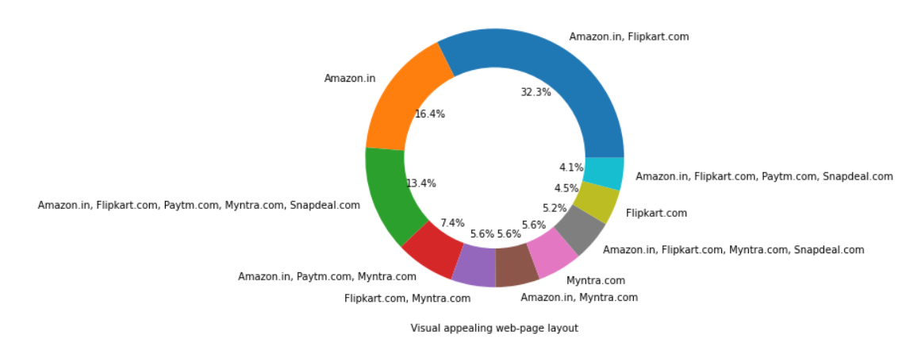
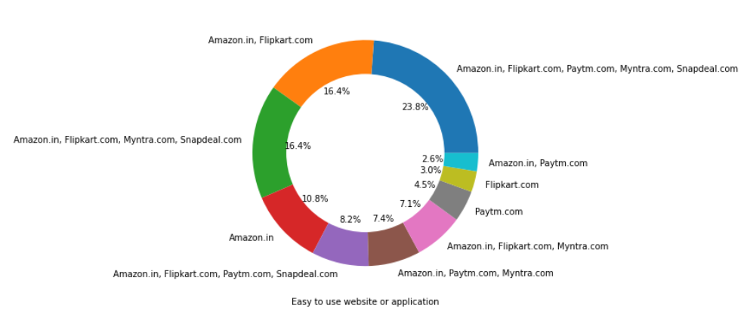
Review of Websites by customers on various performance basis
In regards of visual appealing, Customers feel Amazon, Flipkart, PayTM, Myntra and Snap Deal are good websites.
In regards of easy to use websites, Customers feel Amazon, Flipkart, PayTM, Myntra and Snap Deal are good.

Slide 4
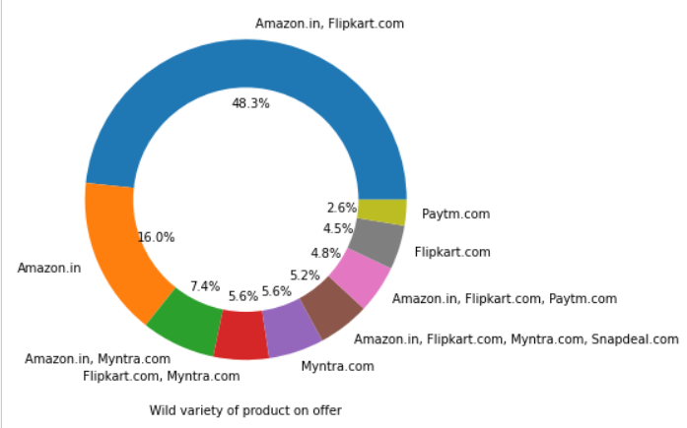
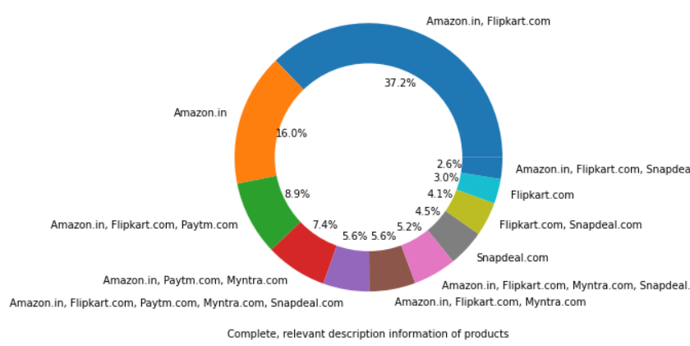
Review of Websites by customers on various performance basis
Customers feel that Amazon and Flipkart have a wild variety of products to offer where Paytm has a least amount to offer.
Customers feel that Amazon, Flipkart and Paytm will have a relevant and complete description of products whereas in Snapdeal very less information.

Slide 5
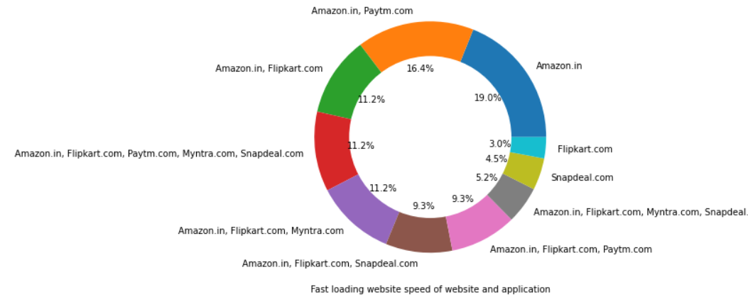
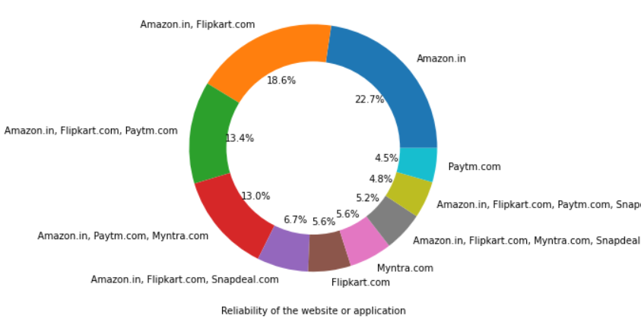
Review of Websites by customers on various performance basis
Customers feel almost all the websites are fast loading but some customers think Flipkart and Snapdeal are somewhat slow in loading.
Most of the customers think Amazon, Flipkart, Paytm and Myntra are reliable websites to shop online.

Slide 6
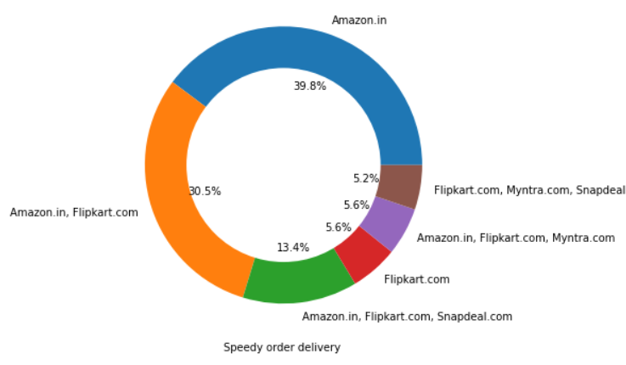
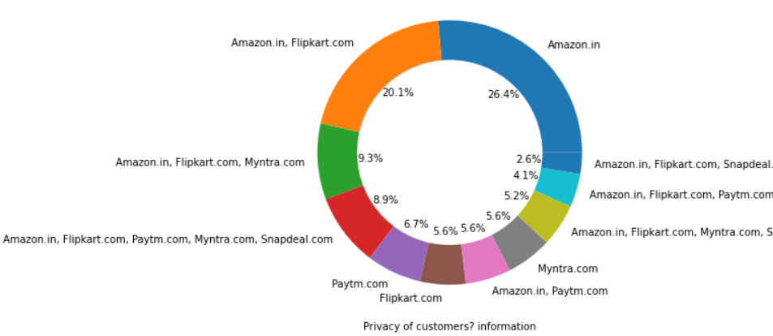
Review of Websites by customers on various performance basis
In regard to speed of delivery, Customers think Amazon and Flipkart are best in business whereas Snapdeal has a less speed in delivery of order.
According to customers, in keeping the privacy of information, Amazon, Flipkart and Myntra are best in business.

Slide 7
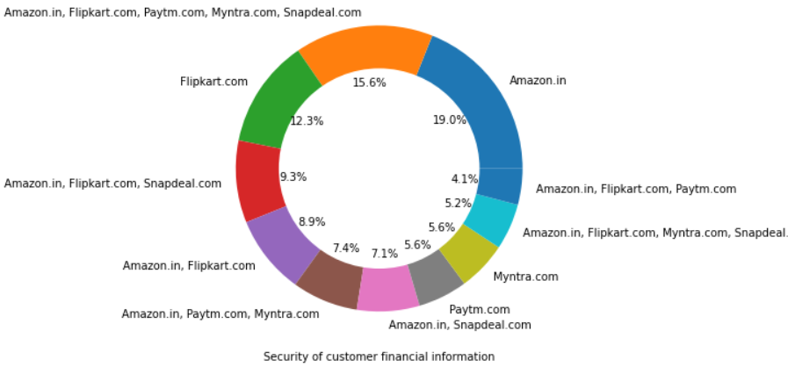
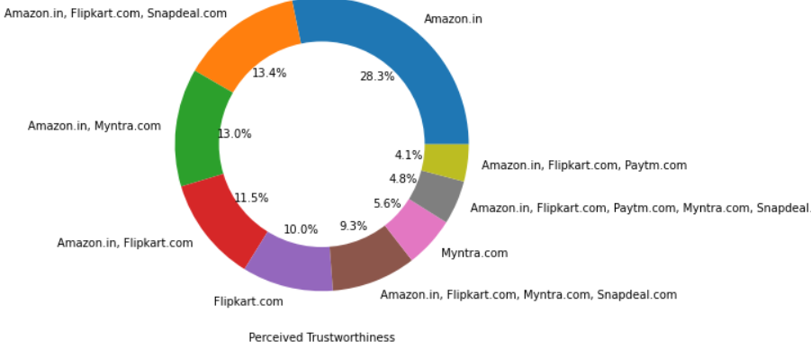
Review of Websites by customers on various performance basis
Customers feel that their financial information is kept secure mostly by Flipkart, Amazon and Snapdeal whereas less secure in Paytm and Myntra.
Amazon, Flipkart, Myntra and Snapdeal websites has perceived good trust-worthiness from the customers.

Slide 8
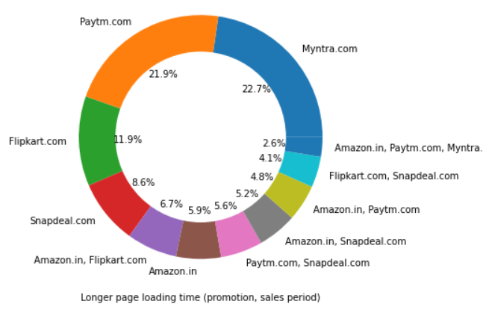
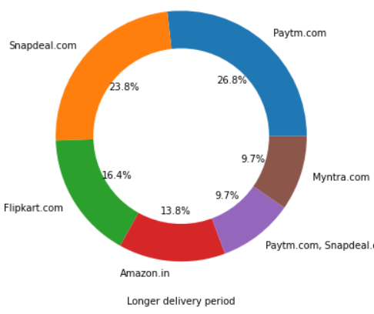
Review of Websites by customers on various performance basis
During the sales period, Customers feel Myntra, Paytm and Flipkart websites takes longer time to load.
According to customers, they feel Paytm, Snapdeal and Flipkart will take longer time to deliver the products.

Slide 9
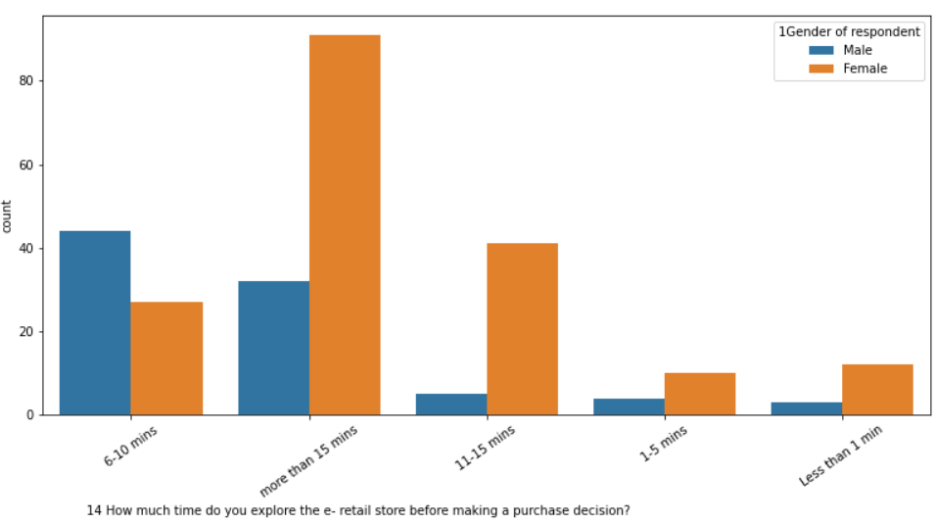
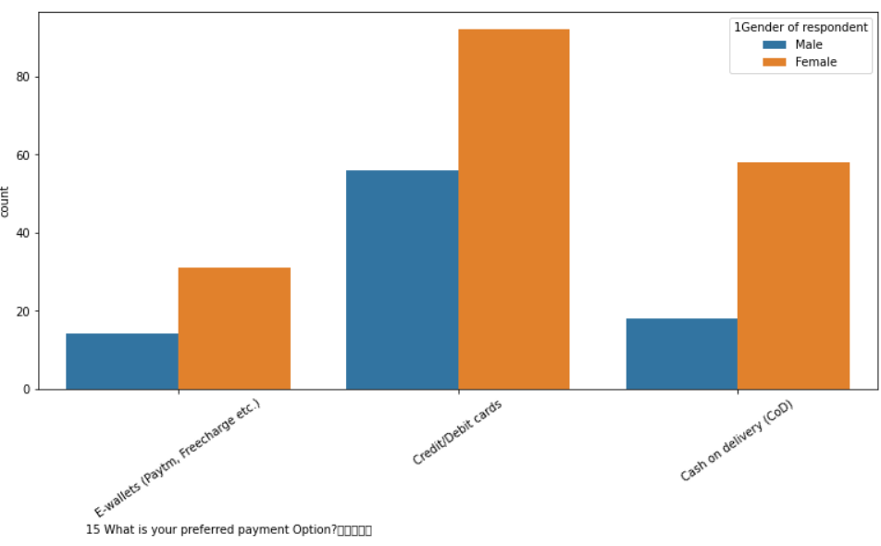
Analysis WRT Gender of Customer
From the following countplot, we can see female spend more time to make a decision to purchase than Men.
Both Men and Women prefers Credit/Debit cards to make purchase in the ecommerce websites.

Slide 10
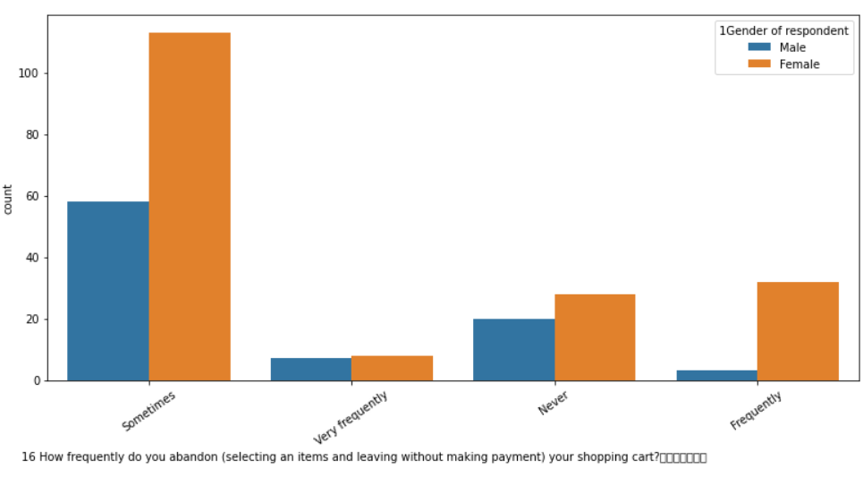
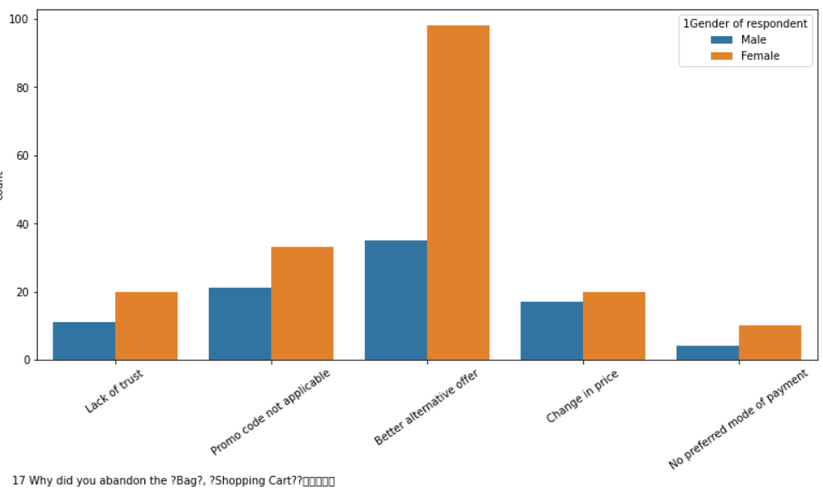
Analysis WRT Gender of Customer
Both Men and Women only sometimes they will abandon the bag without making any payment.
Most of the times, both Men and Women leave the bag abandon because they are getting better price in other websites.

Slide 11
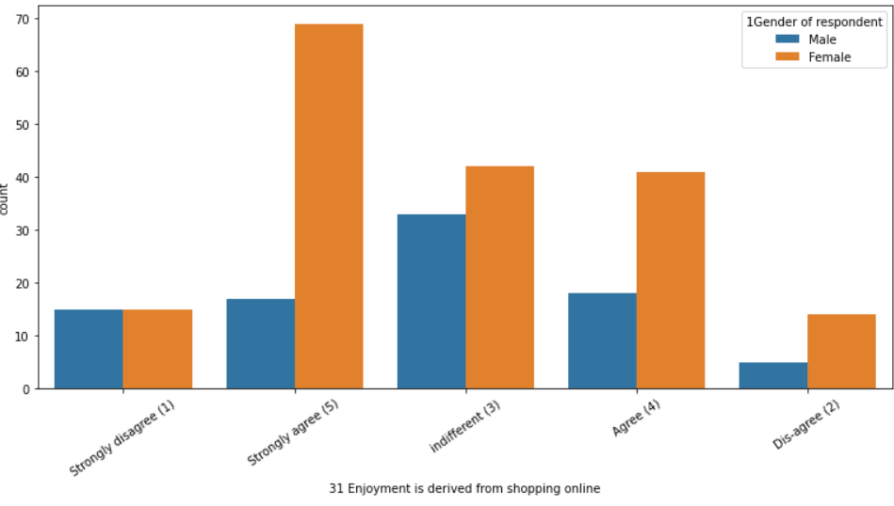
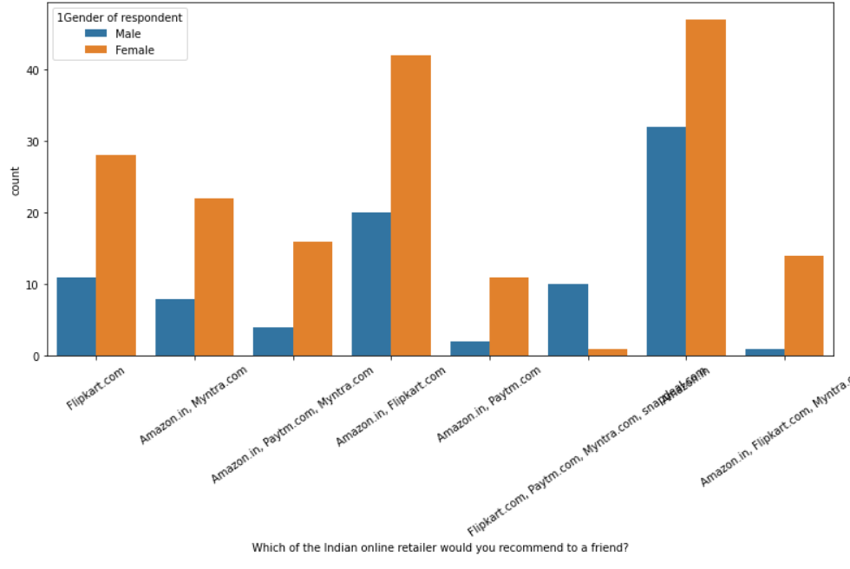
Analysis WRT Gender of Customer
Most of the Women thinks that their real enjoyment is in shopping only where Men does not.
Both Men and Women tends to recommend all the websites except snapdeal to their friends.

Slide 12
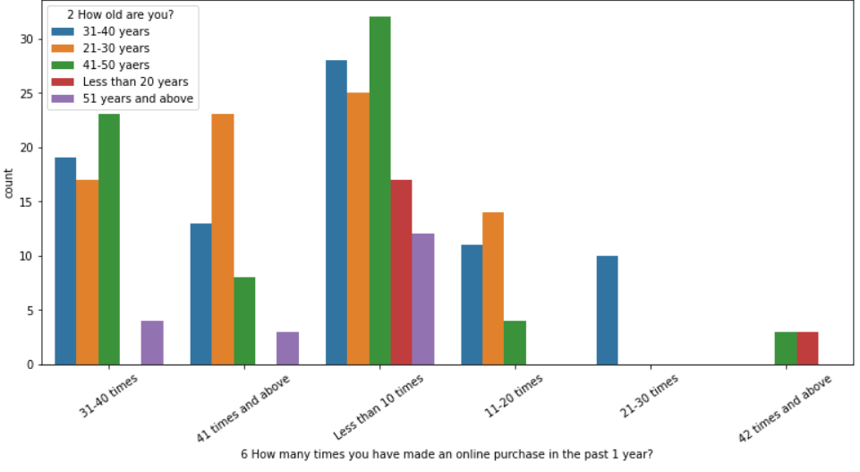
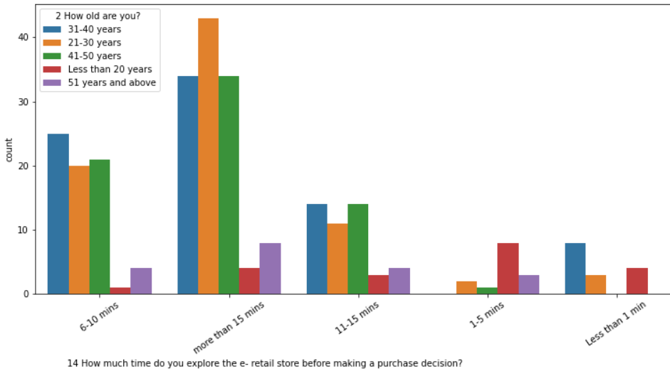
Analysis WRT Age of Customer
Customers whose age less than 20 and customers whose age less than greater than 50 are making very less purchases.
All age groups are spending more than 15 minutes to make a decision to purchase.

Slide 13
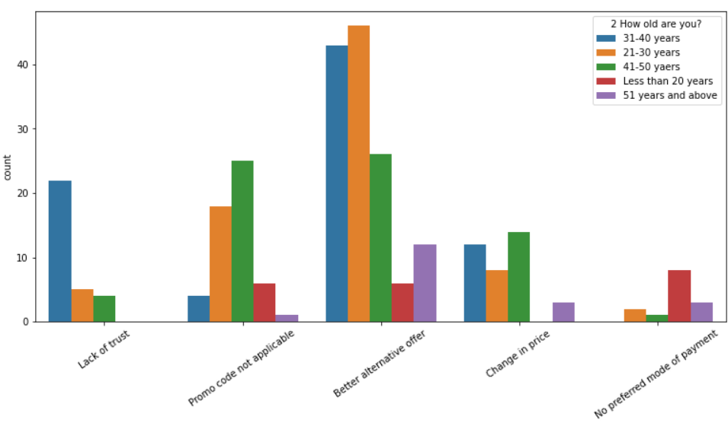
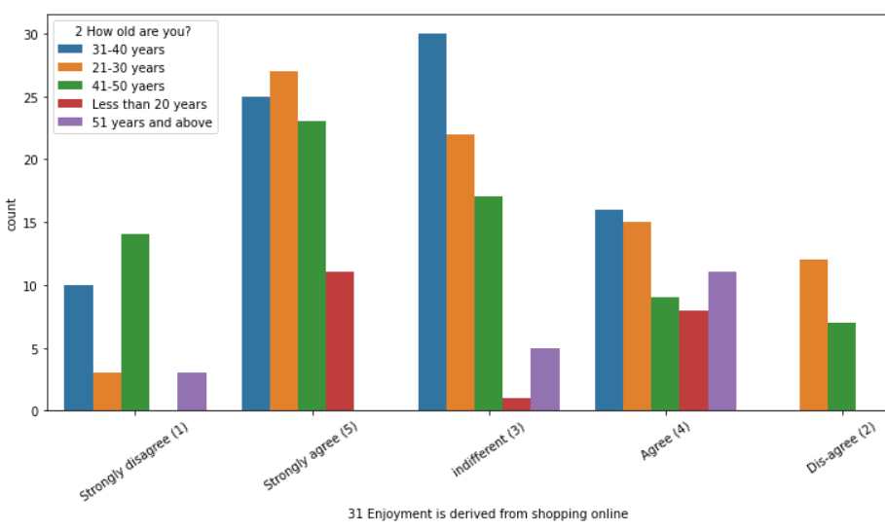
Analysis WRT Age of Customer
All the age groups are abandoning the bag because they are getting better offer. Some people with age 30-40 are abandoning because lack of trust.
Except the customers whose age is greater than 50 are strongly agreeing that shopping is enjoyment.

Slide 14
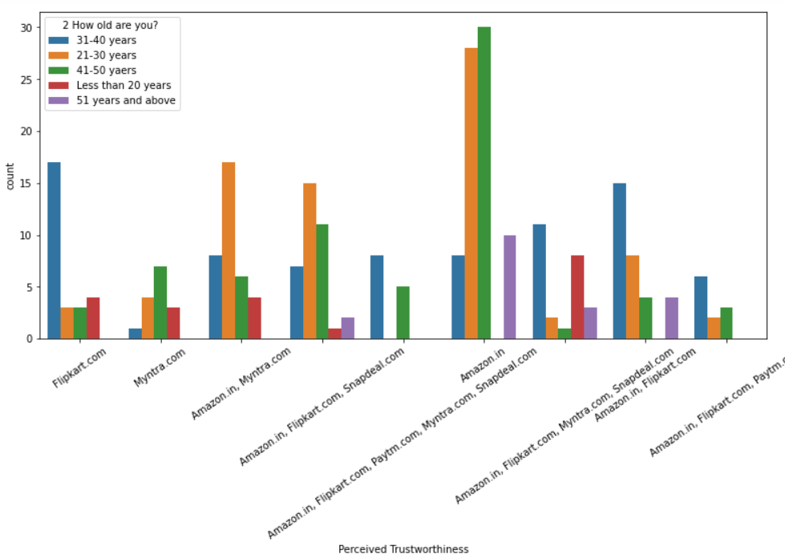
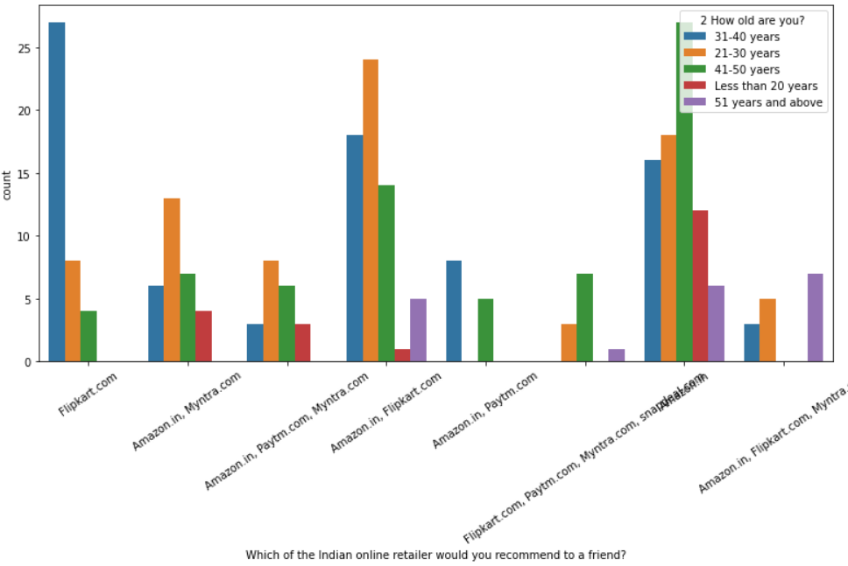
Analysis WRT Age of Customer
All the age groups believes amazon is trustworthy but customers with 30-40 age believes Flipkart is more trustworthy.
Flipkart and Amazon websites are mostly recommended by customers to their friends.

Slide 15
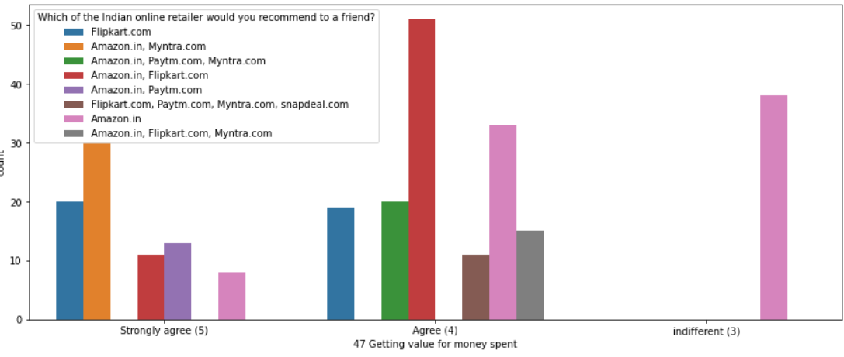
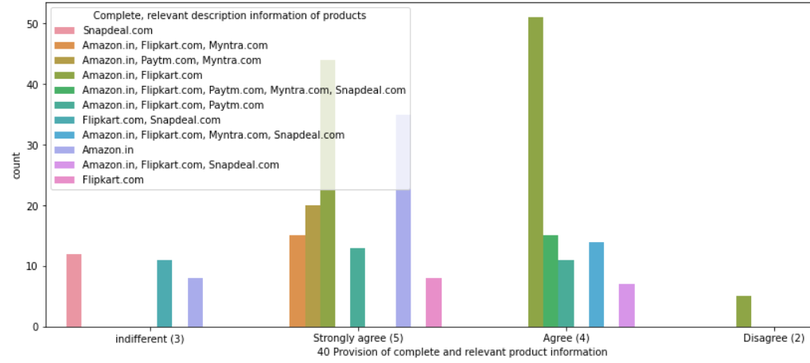
Performance Analysis of Websites
In Amazon, Flipkart and Myntra websites, customers are getting value to their money.
In Amazon, Flipkart and Myntra websites, customers are getting complete information about the product.

Slide 16
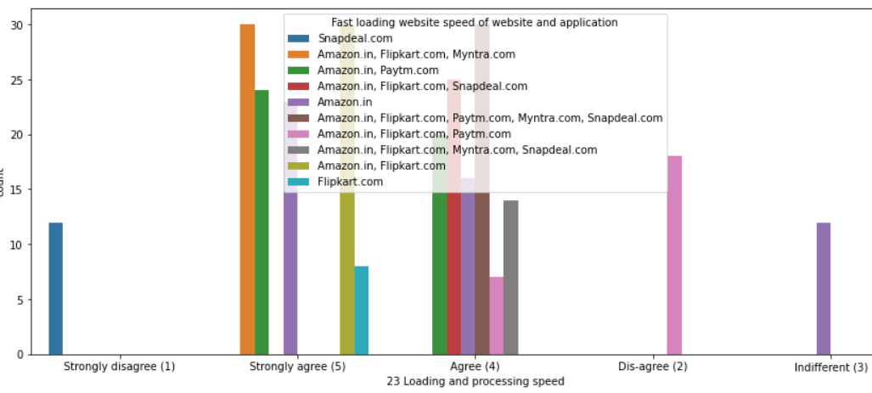
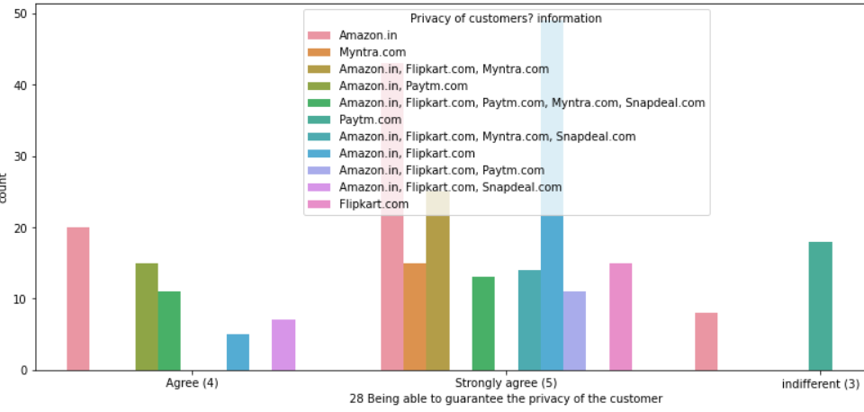
Performance Analysis of Websites
Customers feel that the loading speed of Amazon, Flipkart, Myntra and Paytm websites are high.
According to customers, Amazon and Flipkart are providing better privacy than other websites.

Slide 17
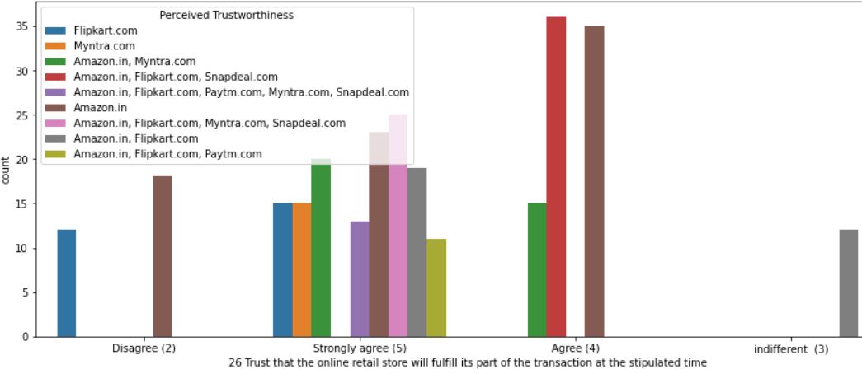
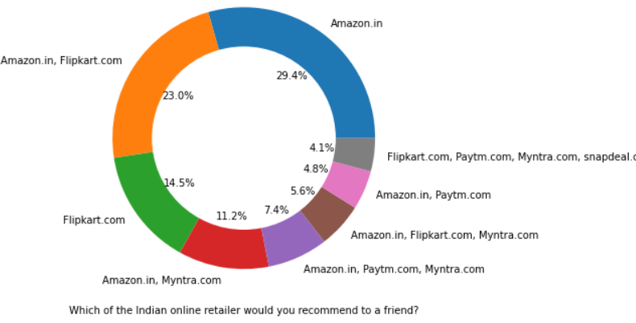
Performance Analysis of Websites
Customers feel that Amazon, Flipkart, Myntra and Snapdeal are trustworthy websites.
Finally, most of the customers prefer Amazon, Flipkart and Myntra websites to shop online .

Slide 18
Conclusion
The results of this study suggest following outputs which might be useful for E-commerce websites to extend their business.
The flexibility of the site, the cost of the products and the offers on the site all play an equally important role in deciding the buying behavior of online customers.
Reliability is also important because customers are paying online, so they need to be sure of security of the online transaction.
E-commerce websites should mainly target on Female customers and customers within the age group 20-40.
Amazon was the most preferred followed by Flipkart. This can be explained easily by previous result that we got. These two companies are most trusted in the industry.

